Slide 1

School of Computing
Vel Tech Rangarajan Dr. Sagunthala R&D Institute of Science and Technology
Department of Computer Science and Engineering
10211CS224 / FULL STACK APPLICATION DEVELOPMENT (JAVA)
PROJECT REVIEW : MILESTONE PROJECT – 1
Date:02-03-2026
Acadamic events registration portal
SDG: SDG No – SDG Title(Example: SDG 4 – Quality Education)
Presented By:
V.Vaishnavi,vtu26447,23UECS0604.
Courses Handling Faculty:
Dr.S.HEMAMALINI,M.E.,Ph.D.,

Slide 2
INTRODUCTION
Background of the Problem:
In many educational institutions, event registration and management processes are still carried out manually or through basic tools like spreadsheets and paper forms. These traditional methods often cause data duplication, miscommunication, and difficulty in maintaining accurate participant records. Event organizers face challenges in tracking registrations, payments, attendance, and feedback efficiently.
Why This Project is Important:
This project is important because it reduces manual effort and minimizes errors in handling event-related data. An automated system saves time for both organizers and participants. It ensures proper data storage, quick access to information, and better coordination of campus activities. It also improves transparency and accountability in event management.
Real-World Relevance:
In real-world college environments, multiple events such as workshops, seminars, cultural programs, and technical fests are conducted regularly. A centralized registration portal helps institutions manage large numbers of participants smoothly. Many modern universities use online portals to simplify event handling, making this project highly practical and industry-relevant.
Brief Overview of the System:
The Campus Event Registration Portal is a web-based application that allows students to view available events and register online. Administrators can create events, manage participant details, track registrations, and generate reports. The system provides secure data storage, automated confirmation messages, and an organized platform to manage campus events efficiently.
1
2
3
4
5
6
7
8
9

Slide 3
PROBLEM STATEMENT
1
- PROBLEM STATEMENT:
In many colleges, event registration is still handled manually through paper forms or unorganized online methods.
This leads to errors in data entry, duplicate registrations, and difficulty in tracking participant details.
Managing payments, confirmations, and attendance records becomes time-consuming and inefficient.
Communication between organizers and participants is often unclear ordelayed.
There is no centralized system to monitor event capacity and generate reports instantly.
As a result, organizers face challenges in planning and managing events effectively.
Therefore, there is a need for a simple, secure, and automated Campus Event Registration Portal.
The system should streamline registrations, manage data efficiently, and improve overall event coordination.
2
3
4
5
6
7
8
9

Slide 4
OBJECTIVE(S)
To design and develop:
a centralized web-based Campus Event Registration Portal that allows students to view, register, and receive confirmation for events online.
To implement :
secure login and database management features to ensure safe storage and easy retrieval of participant and event data.
To improve:
event management efficiency by reducing manual paperwork, eliminating duplicate entries, and enabling real-time registration tracking.
To evaluate the performance :
the system by comparing time saved, reduction in errors, and user feedback against the traditional manual registration process.
1
2
3
4
5
6
7
8
9

Slide 5
PROPOSED SYSTEM
Description of the Solution:
The Campus Event Registration Portal is a web-based application developed to automate the process of event registration and management within a college.
The system allows administrators to create, update, and manage events through a secure login.
Students can view available events, fill out registration forms, and receive instant confirmation online.
All participant details are stored in a centralized database for easy access and report generation.
The system also enables tracking of event capacity and participant lists in real time.
1
2
3
4
How It Solves Existing Issues:
5
It eliminates manual paperwork and reduces errors caused by handwritten forms or duplicate entries.
It simplifies data management by organizing all information in a structured digital format.
It improves communication and coordination by providing quick access to event details and registration status.
6
7
Advantages Over Current Systems
Faster registration process compared to manual methods.
Secure data storage with reduced risk of data loss.
Real-time monitoring of registrations and event capacity.
Easy generation of reports for better event planning and decision-making.
8
9

Slide 6
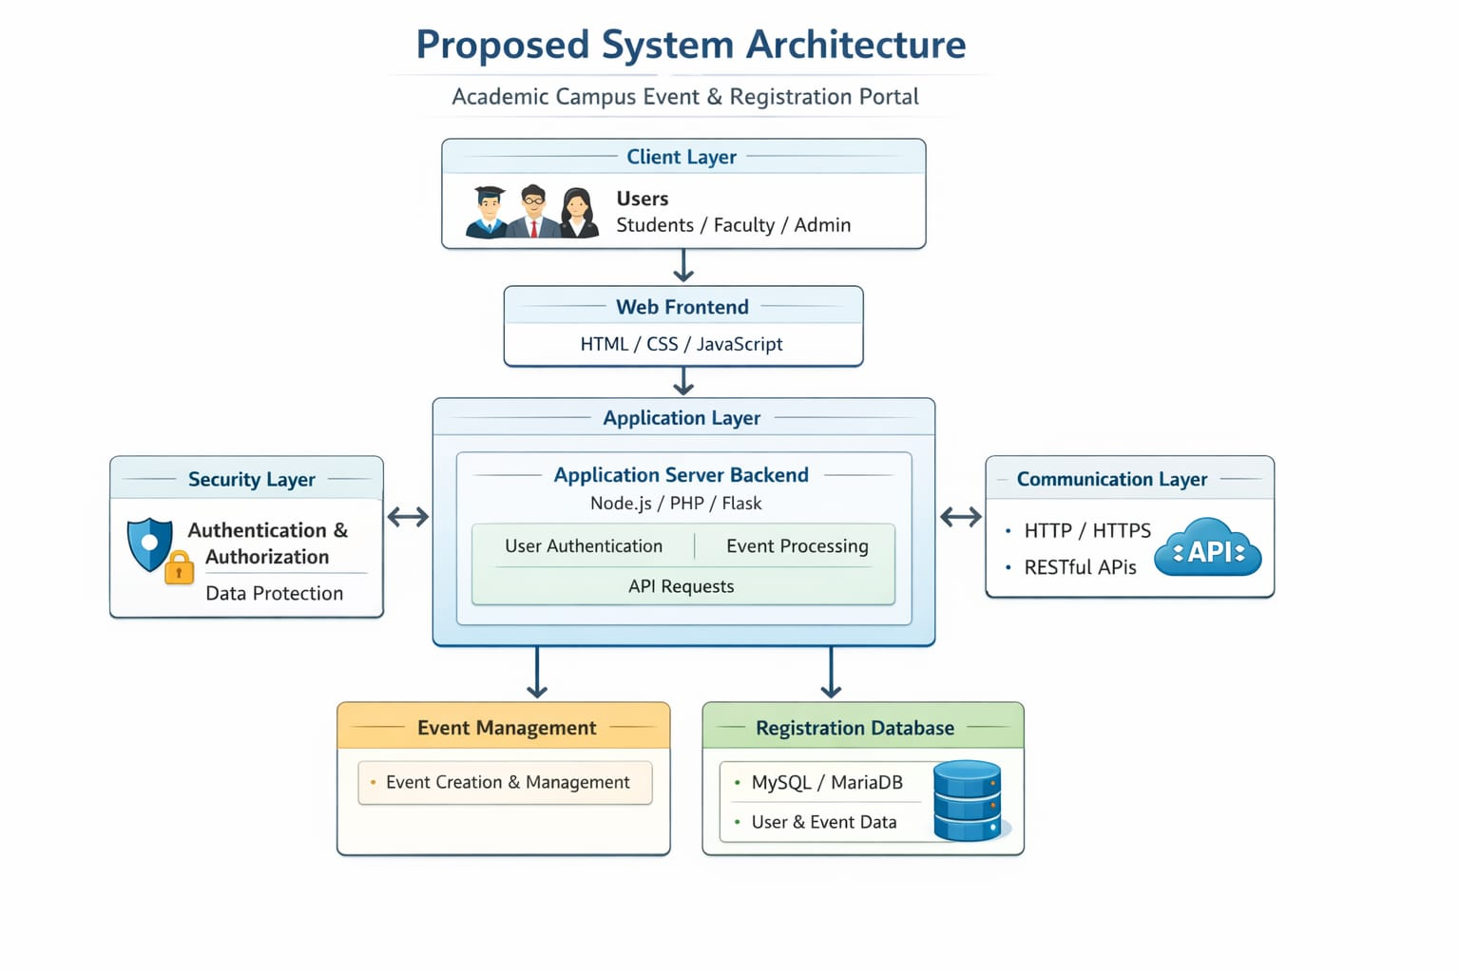
PROPOSED SYSTEM ARCHITECTURE
BLOCK DIAGRAM:
1
2
3
4
5
6
7
8
9

Slide 7
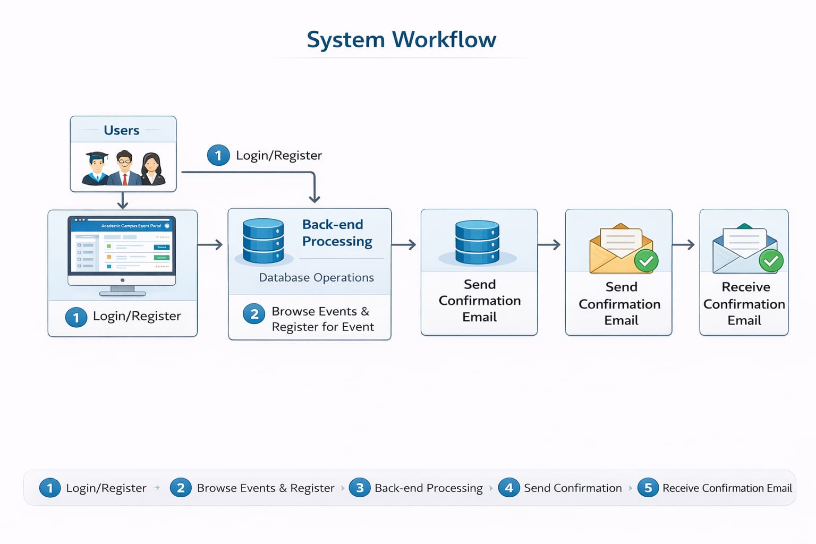
WORKFLOW
(Add dataflow diagram)
1
2
3
4
5
6
7
8
9

Slide 8
TECHNOLOGIES USED
Frontend: HTML CSS
Backend:
Node.js
Database:
MySQL
Tools:
Visual Studio Code (Code Editor)
My Sql Workbench
Hardware Requirements:
Operating system Web browser Visual Studio Code
1
2
3
4
5
6
7
8
9

Slide 9
MODULE DESCRIPTION
Module 1: User Authentication & Management
Handles student and admin registration, login, and logout functionality. Ensures secure authentication using username and password validation. Manages user profiles and controls access based on roles (Student/Admin)
1
2
3
Module 2: Event Management
Allows admin to create, update, and delete event details such as event name, date, venue, and participant limit. Enables students to view available events with complete information.
Manages event capacity and availability status.
4
5
6
Module 3: Registration Management
Processes student event registrations.
Validates form inputs and prevents duplicate registrations.
Stores registration details in the database and generates confirmation messages.
7
8
Module 4: Database & Reporting
Maintains structured storage of student, event, and registration data. Generates participant lists and event-wise reports for admin.
Ensures data accuracy, integrity, and easy retrieval for analysis.
9

Slide 10
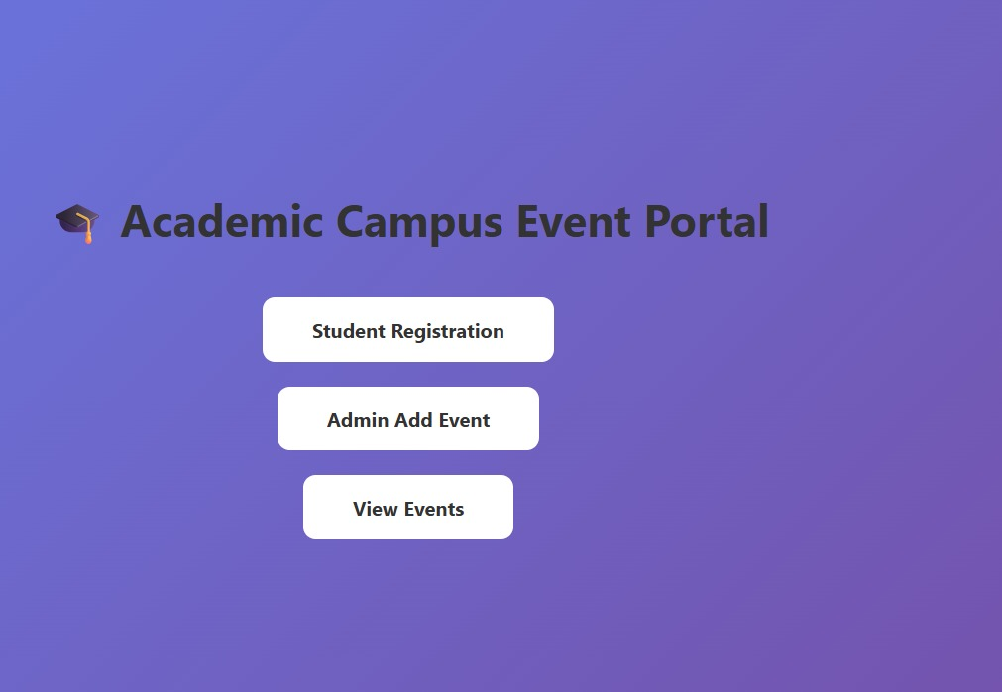
IMPLEMENTATION SCREENSHOTS
1
2
3
4
5
6
7
8
9

Slide 11
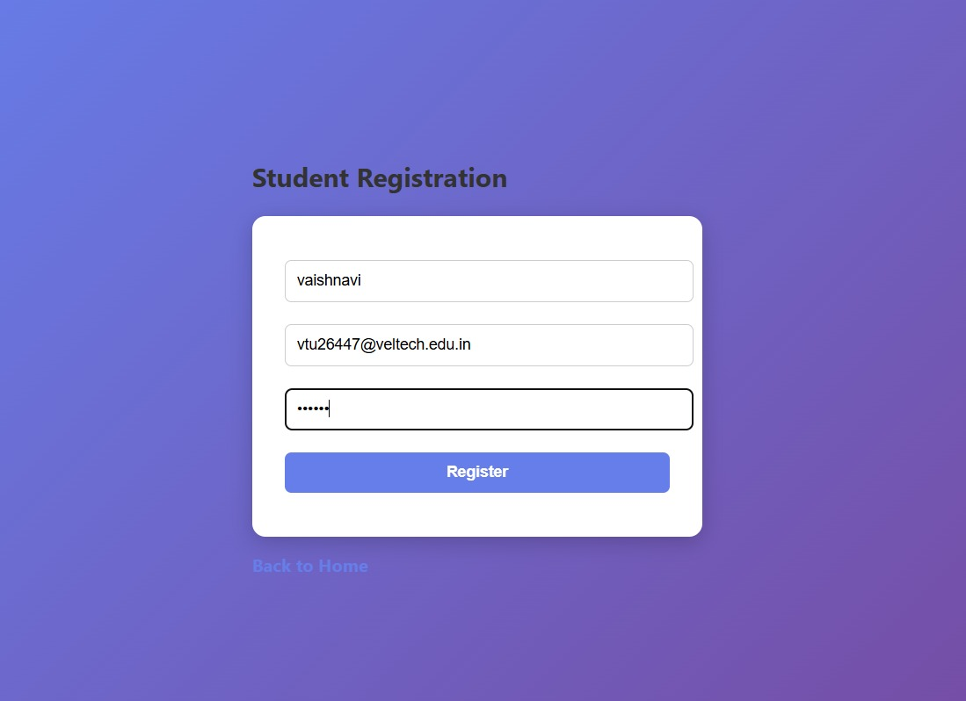
IMPLEMENTATION SCREENSHOTS
1
2
3
4
5
6
7
8(A)
9

Slide 12
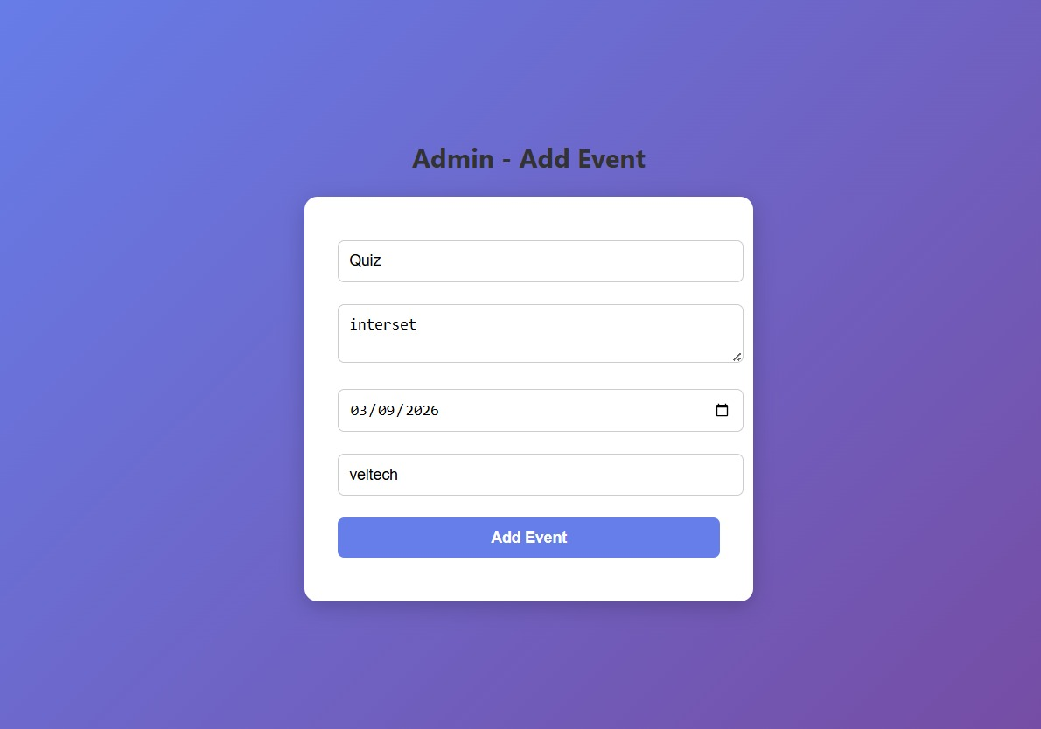
IMPLEMENTATION SCREENSHOTS
1
2
3
4
5
6
7
8(B)
9

Slide 13
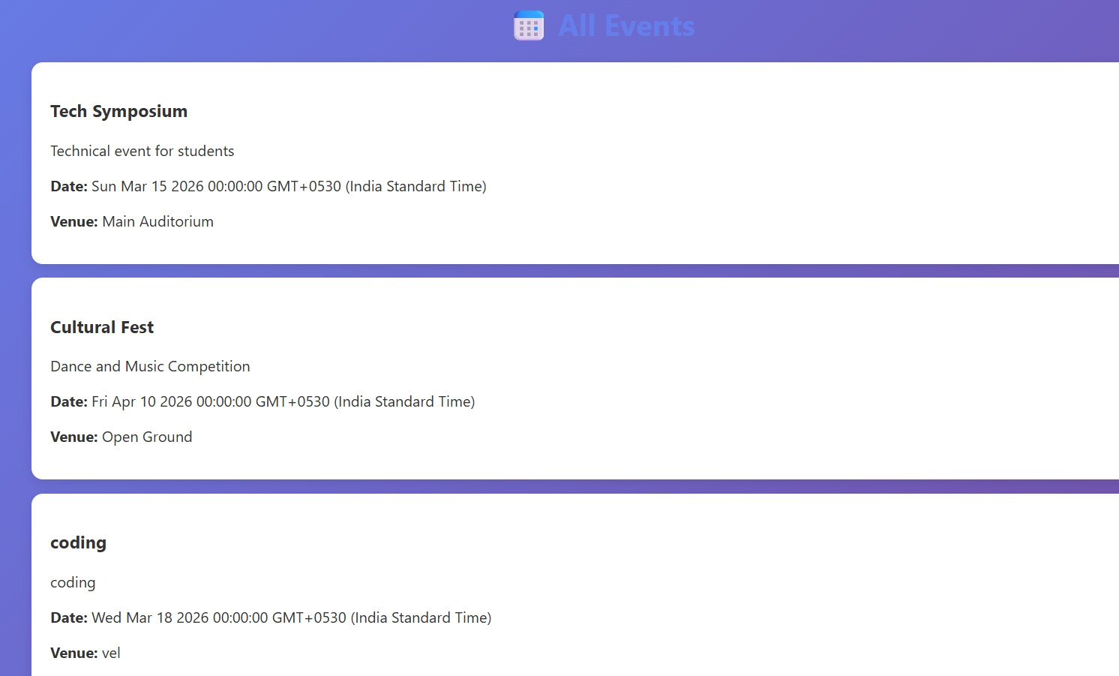
IMPLEMENTATION SCREENSHOTS
1
2
3
4
5
6
7
8(C)
9

Slide 14
ADVANTAGES AND LIMITATIONS
1
ADVANTAGES:
One unified digital gateway replaces paper forms, WhatsApp chaos, and manual approvals.
Live dashboards track registrations, demand spikes, drop-offs—turn events into data assets.
Auto-confirmations, QR check-ins, waitlists, and certificate generation eliminate admin burnout.
AI-based event recommendations based on interests, department, behavior.
LIMITATIONS:
Students with weak internet or low digital literacy get excluded.
Clubs and faculty may cling to legacy tools (Google Forms, WhatsApp).
Mishandled student data erodes trust instantly.
Peak registration crashes damage credibility.
Requires continuous updates, moderation, and technical ownership.
2
3
4
5
6
7
8
9

Slide 15
Thank you

